Slide 1
Buying and oversight
How do I question a vendor, and how do I keep control of what I buy?
Applied AI and Automation | Session 10 of 12
KLAi Professional Learning | Jotham Martin Wambi
Notes:
Welcome to Session 10. Today you meet a vendor proposal and take it apart, and you see how two fresh AI chats did the same job. Start with your question from last time: which AI product has someone pitched to you, or which tool do you already pay for?
You do not build anything today. You learn what to ask before you buy, and what to keep control of afterwards.

Slide 2



Today in one view: what you will leave with
By the end of today you will have
A reading of a vendor proposal you can defend, set beside two real AI reviews of the same proposal
Five questions for your own vendor, each with the answer that would be a red flag
An oversight card on your Workbook page for a bought tool: data location, terms, exit, audit and owner
Notes:
Here is what you leave with. A reading of a vendor proposal that you can defend, set beside two real AI reviews of the same document. Five questions for your own vendor, each with the answer that would worry you. And an oversight card for a tool you buy, with data location, terms, exit, audit and an owner. You need no technical knowledge for any of it.

Slide 3
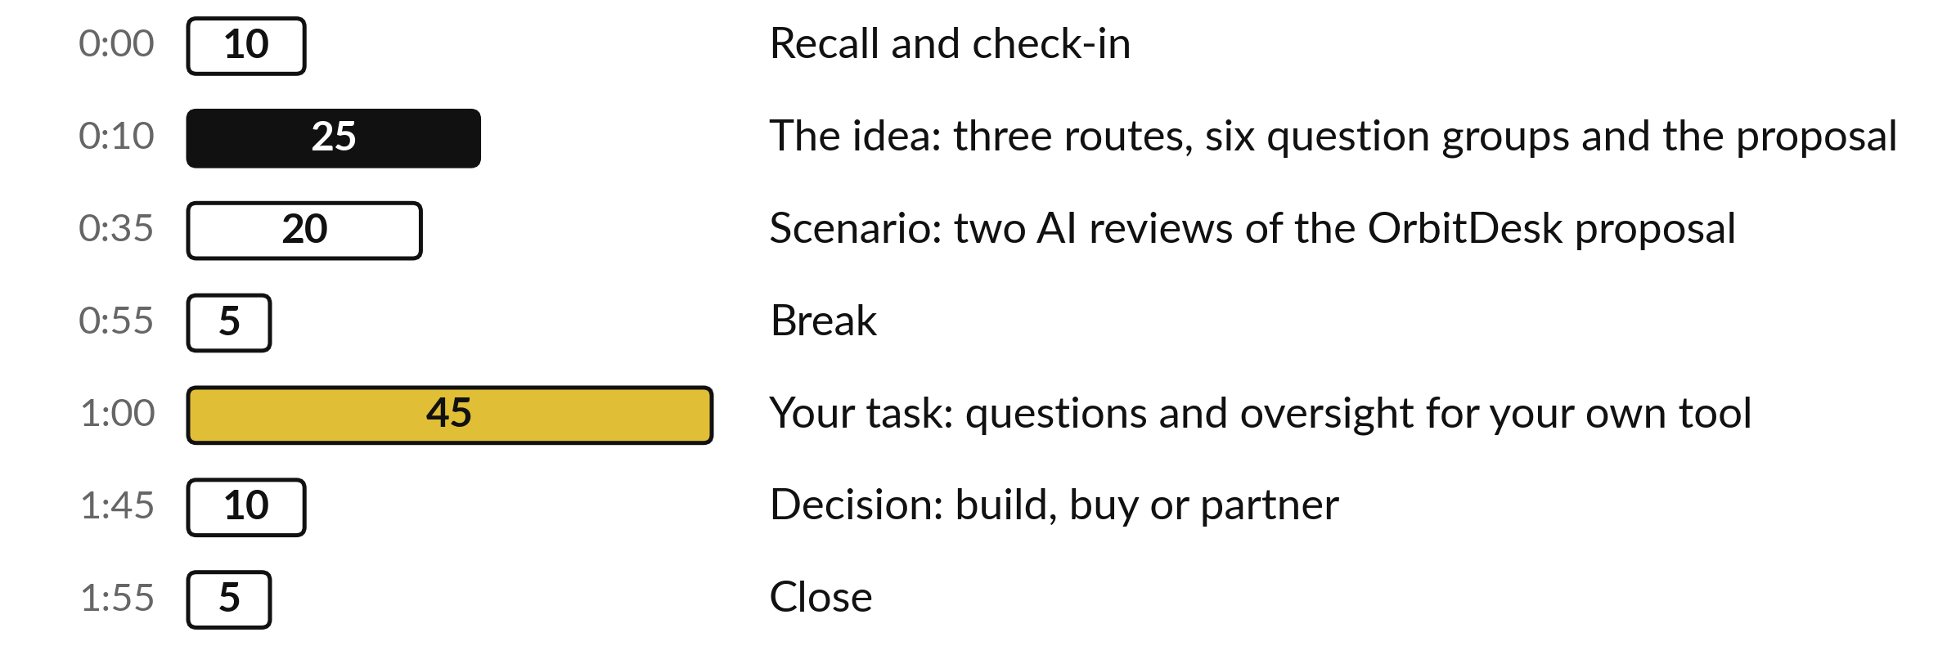
Your two hours: 45 minutes are your own work
45 of the 120 minutes are yours: questions and oversight for a tool your company uses or may buy.
Notes:
Three parts take most of the time. Twenty-five minutes on the idea: the three routes, the six groups of questions and how a proposal reads. Twenty minutes on a scenario, where you mark the OrbitDesk proposal and then see two AI reviews of it against the answer key.
After the break, forty-five minutes are yours, on a tool from your own company. The last ten minutes are for your choice of build, buy or partner.

Slide 4

Three questions from last time
1. How is a risk scored, and which scores are High?
2. Name the data classes in your policy table.
3. At Nile Valley Foods, who hears about a suspected data loss, and how fast?
Answer aloud first. Then we check together.
Notes:
Three quick questions from Session 9. Answer aloud first, and then we check together. It is a warm-up to bring last time back.
Question one. How is a risk scored, and which scores are High? Take a moment.
A good answer is this. Likelihood from 1 to 5 times impact from 1 to 5. High is 15 or more, Medium is 8 to 14, Low is below 8.
Question two. Name the data classes in your policy table. Say it to yourself first.
A good answer is this. Public, internal and confidential, with a flag for personal data.
Question three. At Nile Valley Foods, who hears about a suspected data loss, and how fast? Think about your own task as you answer.
A good answer is this. The Operations Manager, within 4 hours (handbook clause 5.3). Nobody is punished for reporting in good faith (clause 5.5).
If an answer was missing, your own task card or last workbook page has it. Now to today.

Slide 5





Words we use today
Word | What it means
Build, buy, partner | Make it with your own people, licence a product, or pay a firm to build and support it.
Red flag | A claim, a term or a silence in a proposal that is a reason to question the vendor or to stop.
Pilot | A small, time-limited trial on your own data, with a baseline, a success measure and a stop rule.
Exit clause | The contract words that say how you leave, get your data back and have it deleted.
Sub-processor | Another company that handles your data on the vendor’s behalf.
Notes:
Five words for today. I give the plain meaning of each, and we use every one of them before the end of the session.
Build, buy, partner. Make it with your own people, licence a product, or pay a firm to build and support it.
Red flag. A claim, a term or a silence in a proposal that is a reason to question the vendor or to stop.
Pilot. A small, time-limited trial on your own data, with a baseline, a success measure and a stop rule.
Exit clause. The contract words that say how you leave, get your data back and have it deleted.
Sub-processor. Another company that handles your data on the vendor’s behalf.

Slide 6
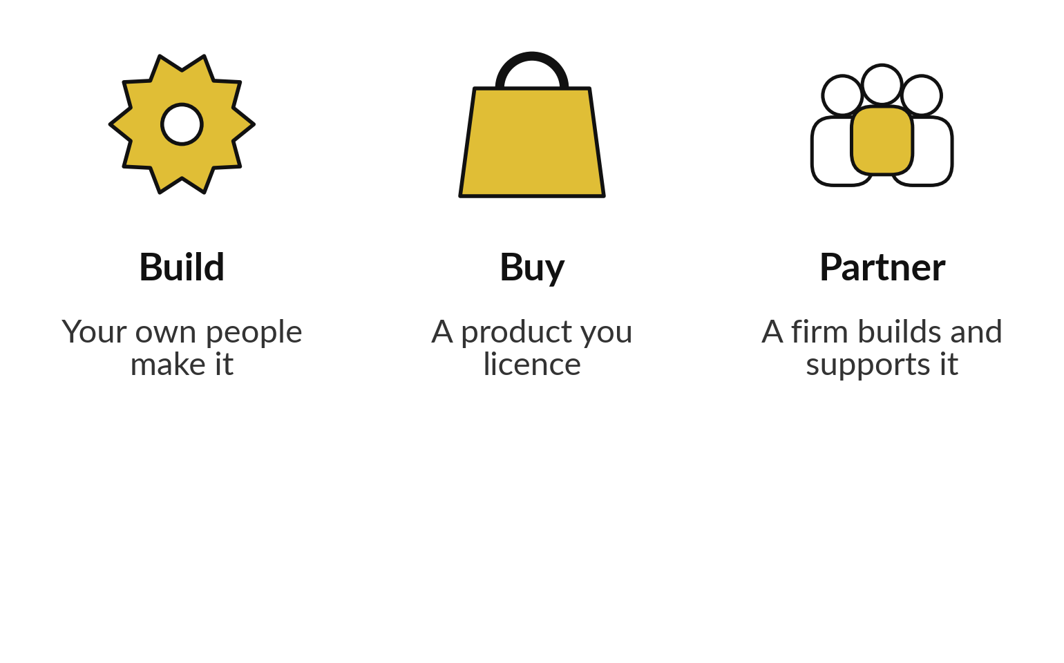
You can build it, buy it or
partner, and you stay responsible
You are responsible for the result on every route.
Build suits a task that is yours alone.
Buy suits a task many companies share.
Partner adds set-up and support you lack.
Notes:
Three routes. Build means your own people make it, in the way I showed you with a rule in Session 6 and an AI workflow in Session 8. Buy means you licence a product that many companies use. Partner means a firm builds and supports it for you.
Build suits a task that is yours alone. Buy suits a task many companies share. Partner suits you when you lack set-up and support. Whichever route you take, you stay responsible for the result and for the data you hand over. Today is about the buy and partner routes, because that is where proposals arrive.

Slide 7






Six groups of questions to ask any AI vendor
Data and privacy: training on our data, where it is kept.
Security: which standard, and the report.
Accuracy evidence on our kind of data.
Pricing drivers: per user, per task or by usage.
Contract and exit: term, renewal, leaving.
Support and references we can call.
Notes:
Six groups of questions, and they match the Vendor Question List in your templates. Data and privacy: do they train on our data, and where is it kept?
Security: which standard do they hold, and can we see the report?
Accuracy evidence: what shows it works on our kind of data?
Pricing drivers: is the price per user, per task or by usage?
Contract and exit: how long, how it renews and how we leave. Support and references: who helps, and who can we call?
The list holds thirty questions, five in each group. You will not ask them all. Later you pick the five that matter most.

Slide 8
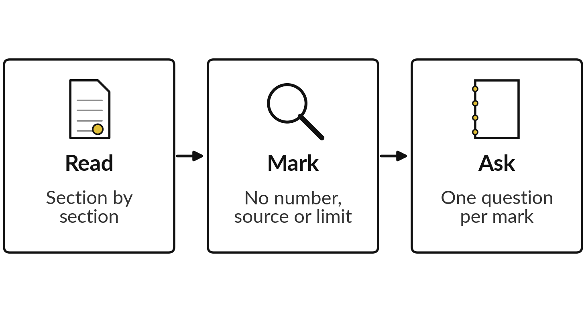
Scenario: read the OrbitDesk proposal
and mark what you cannot check
I will show
Watch for
A claim with no number, source or limit.
What the vendor asks you to share or sign.
What the proposal leaves out.
Notes:
Now the scenario. OrbitDesk is an invented vendor, and its proposal is a teaching document written for Nile Valley Foods, so no real company is described. It is addressed to the Finance Manager, Joseph Mugisha. Take ten minutes with your printed copy of the proposal and a highlighter.
Read it section by section and mark every claim that has no number, no source or no limit. Write a question beside each mark. Do not look for a set number of problems. When ten minutes are up, we see what two AI chats made of the same pages.

Slide 9
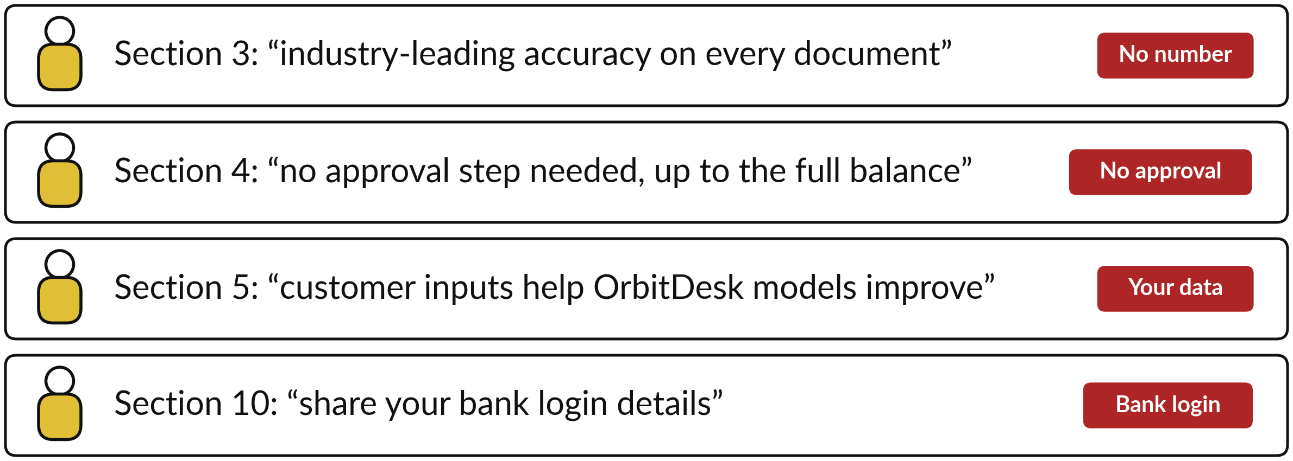
Four lines from the proposal
that a careful reader stops at
Notes:
Here are four lines from the proposal, in the vendor’s own words. Section three promises industry-leading accuracy and gives no number. Section four lets the agent pay suppliers with no approval step, up to the full balance of the bank account. Section five says customer inputs help the vendor’s models improve for everyone, which means your data trains a product that others use.
Section ten asks you to share your bank login details. Compare these with your own notes. You may have found these, and you may have found others that I have not shown.

Slide 10
Two fresh AI sessions reviewed
the proposal with the key hidden
Claude, a fresh session given only the prompt, 4 November 2026, answer key hidden. Two runs. Not ChatGPT or Gemini. Another product or day may differ.
What it was asked
“Review it. List the claims you would question and why, any red flags, and the eight most important questions to ask the vendor.”
What it had
The proposal text and the request. No answer key. The proposal said it was fictional, and both runs noticed.
What we compare
Each run against the 11 red flags planted in the proposal.
Notes:
Before the results, here is how they were made. On the fourth of November 2026 I gave the proposal text to Claude in two separate fresh sessions, each given only the prompt, with the answer key hidden. The prompt told it to use no other file or tool, and it wrote its answer to a file.
The proposal is headed fictional teaching document, and both runs said so in their first line, so the AI knew it was a test. A real proposal would not say that. The request was short: review it, list the claims you would question and the red flags, and write the eight most important questions.
This is not ChatGPT or Gemini, and another product or another day may give a different answer. Two runs is a small sample. The proposal has eleven planted red flags, and I compared each run with them line by line.

Slide 11
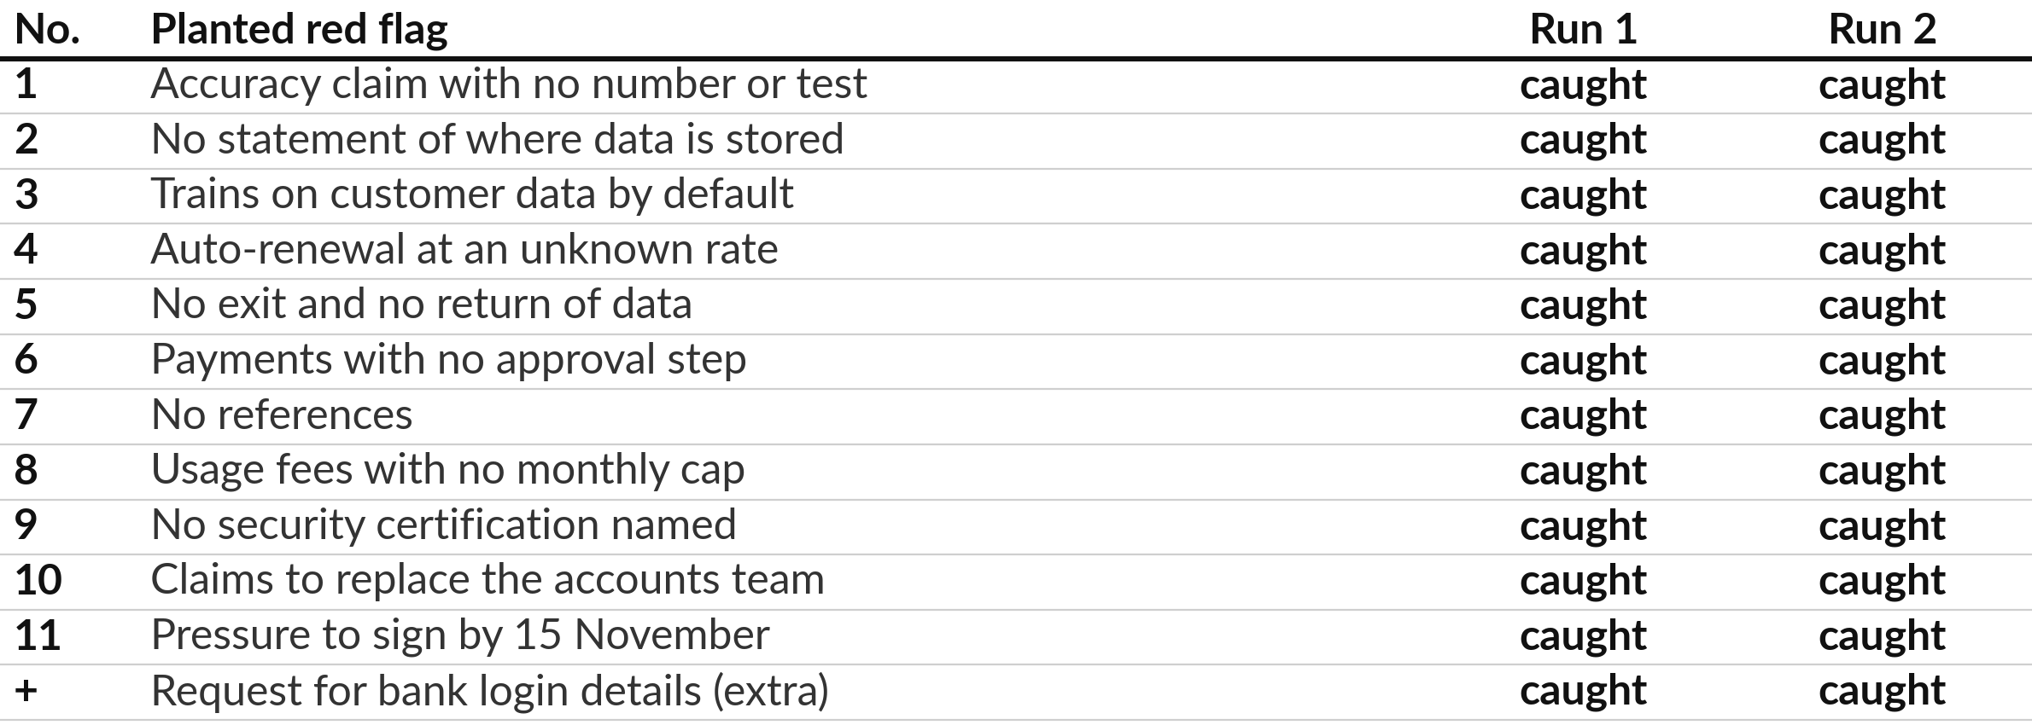
Both runs caught all 11 planted red
flags in one deliberately blunt proposal
Claude, a fresh session given only the prompt, 4 November 2026, answer key hidden. Two runs.
Notes:
Here are the results. The eleven planted red flags are in the middle, and the two runs are on the right. Both runs caught every one of the eleven, and both also caught the request for bank login details, which the key lists as an extra. I read both answers in full to be sure, and I found each flag in the text.
Neither run missed anything the key lists. That is a strong result for a review, and it is only two runs on one proposal. Keep the next three slides in mind, because the catch is not the whole story.

Slide 12








Both runs wrote eight groups of
questions on the same eight topics
Topic | Run 1 asked | Run 2 asked
Payments | Approval, limits, supplier whitelist | Limits, two-person approval
Bank access | Why bank logins at all? | Why bank logins? Which banks are live?
Accuracy | Measured accuracy, own-invoice pilot | Error rates, a month in parallel
Your data | Training opt-out, location, exit | Location, training off, export
Security | ISO 27001 or SOC 2 reports | The reports, and Ugandan registration
References | Two similar customers | Three similar customers
Liability | Who pays, insurance, reversal | Who pays, insurance, fraud
Cost and exit | What is an action? Caps, pilot | Action, caps, the list price
Run 1 turned none of the three claims into a question. Run 2 asked only about the 15 November deadline. Neither asked about replacing the team or the 60-day payback.
Notes:
Next, what each run asked. Both wrote eight numbered questions, each bundling several, and they cover the same eight topics: payment controls, bank access, accuracy evidence, your data, security, references, liability, and cost and exit. The wording differs. Run two asked which Ugandan banks and mobile money providers were already live, and asked about registration in Uganda, which run one did not.
Run one asked for two references and run two asked for three. Neither turned the claim to replace your accounts team or the sixty-day payback claim into a question. Run one asked nothing about the pressure to sign by fifteenth November. Run two asked what the list price is behind that deadline. The rest stayed in the red-flag text.

Slide 13






Both runs added points the key does not list
Extra point | Run 1 | Run 2
Minimum commitment is the monthly fee times 36 | Yes | Yes
No liability, insurance or way to reverse an error | Yes | Yes
“Action” is never defined, so usage cost is unknown | Yes | Yes
Pilot in read-only mode with every payment approved | Yes | Yes
Invoice fraud and changed supplier bank details | Partly | Yes
A licence may be needed to start payments | No | Yes
Two runs. The key itself lists the 60-day payback claim, extra support fees and the bank login as extra finds, and both runs caught those.
Notes:
Both runs also went beyond the key. Both worked out that the minimum commitment is the monthly fee times thirty-six months, before any usage charge, and I checked that arithmetic. Both pointed out that there is no liability, no insurance and no way to reverse an error. Both noticed that an action is never defined, so usage cost is unknown.
And both advised a read-only pilot with every payment approved. Run one named a fraudulent invoice but not changed supplier bank details. Run two raised both, and alone asked whether a licence is needed to start payments. This is where a review helps you most: it widens your list.

Slide 14


The AI review helped, and
you still do the checking
In these two runs
What you still do
All 11 red flags, both times
Eight groups of questions each
A sensible next step: a read-only pilot
Check its quotes: run 2 invented two
Judge the vendor’s written answers
Check claims it stated as fact
Two runs on a blunt proposal. Real proposals are often quieter.
Notes:
So what does this tell us?
On the left, the AI review was useful. It found everything the key lists, it wrote eight groups of questions, and it gave a sensible next step. On the right, what stays with you. Run two put two phrases in quotes, tens of thousands of invoices and sign now, start tomorrow, and I searched the proposal: neither is there.
Both runs also stated what banks forbid as a fact, and you should check that with your own bank. And the AI has not met the vendor. This proposal plants its flags openly, and real proposals are often quieter.

Slide 15
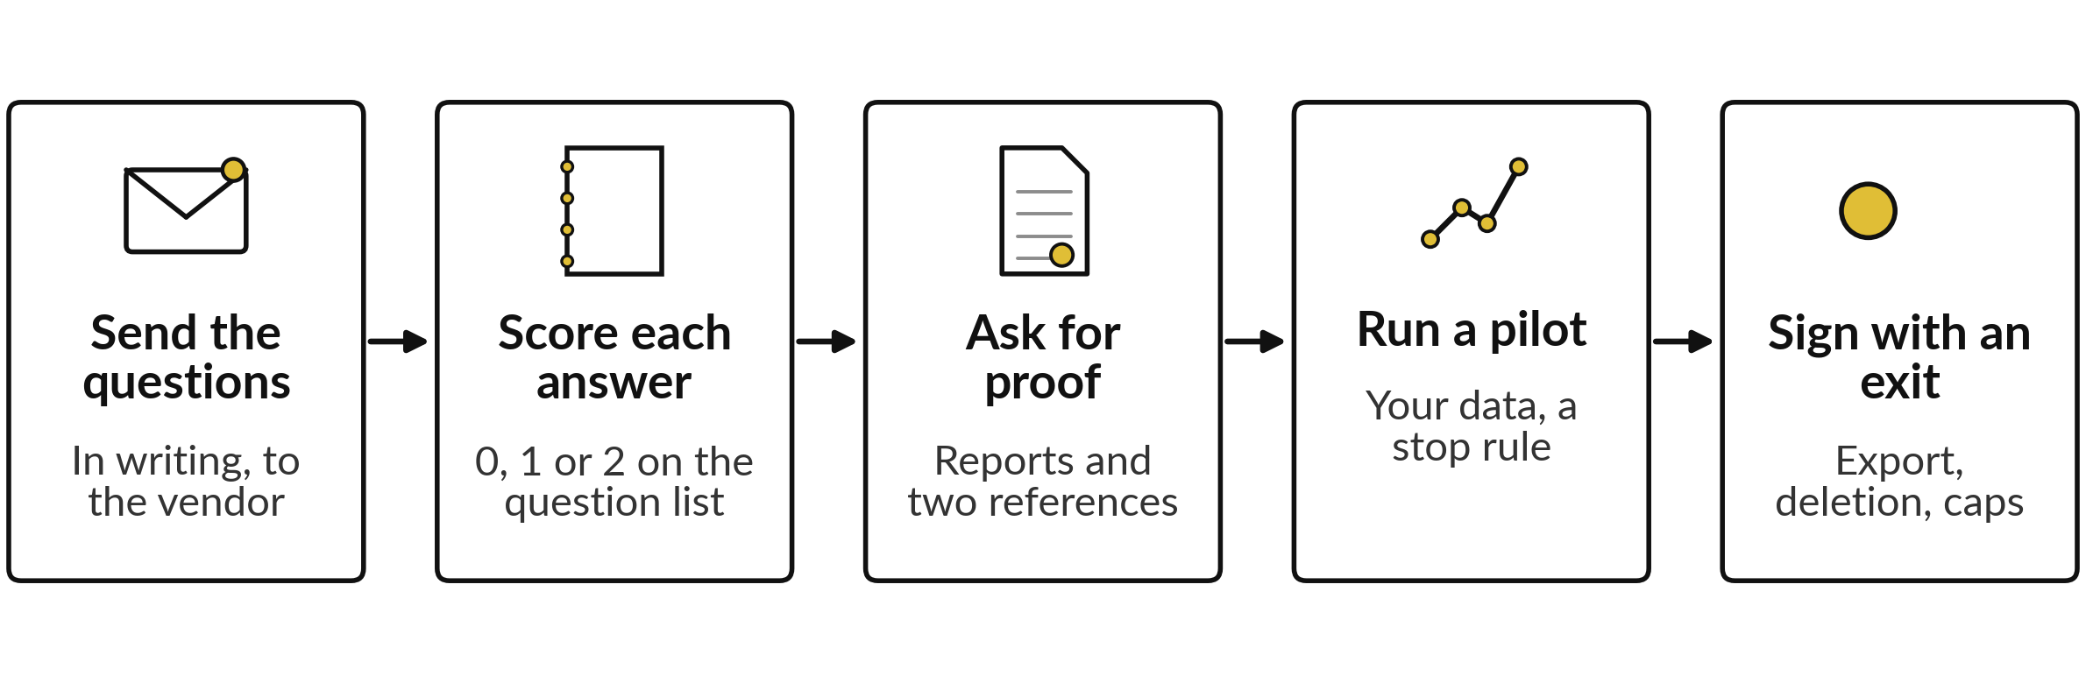
A review is the start of oversight,
and five steps follow it
On the Vendor Question List, a 0 in data and privacy, security, or contract and exit is a reason to stop.
Notes:
A review is where oversight starts. It does not finish the job. First send the questions in writing, so that the answers are on record. Score each answer zero, one or two on the Vendor Question List: zero for a red flag, a refusal or silence, one for partial or not in writing, two for clear and in writing.
Then ask for proof, such as the audit report and two customers you can call. Run a pilot on your own data with a stop rule. And sign only with an exit. A zero in data and privacy, security, or contract and exit is a reason to stop.

Slide 16





Five oversight controls for a tool you buy
Control | What you set | OrbitDesk gap it catches
Data location | Countries, sub-processors, training switched off | Flags 2 and 3: no location, trains on your data
Terms | Term, renewal price cap, notice, usage cap | Flags 4 and 8: auto-renewal, no cap
Exit | Data export, deletion date and proof | Flag 5: ends only at renewal
Audit | Approval records, an exportable log, reports | Flags 6 and 9: no approval step, no certificate
Owner | One named owner, a deputy and an off switch | Flag 10: nobody left to oversee it
Notes:
Once you buy, five controls keep the tool in your hands. Data location: the countries, the sub-processors and training switched off. Terms: the length, a cap on the renewal price, a notice period and a cap on usage. Exit: how you export your data, the date it is deleted and proof of deletion.
Audit: approval records, an exportable log and the vendor’s reports. Owner: one named person, a deputy and an off switch. The third column shows which OrbitDesk problem each control would have caught. Which of the five is weakest for a tool your company already uses?

Slide 17
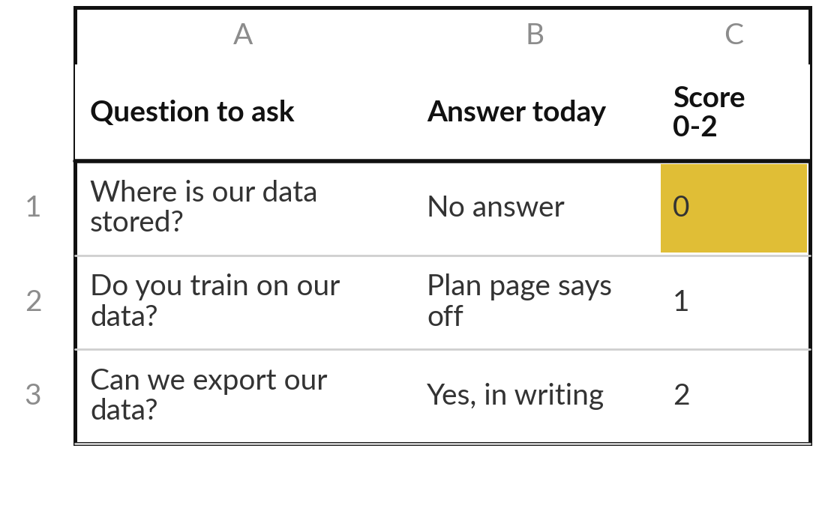
Practice: find what you do
not know about one tool
15 minutes
Your own company task
Answer the first questions about a tool your company uses, trials or was pitched.
Pick one tool: bought, on trial or pitched.
Open the Vendor Question List. Answer groups 1, 2 and 5 from what you know today.
Write no answer where you do not know. A silence scores 0.
Circle your three biggest gaps.
You keep: Three gaps in what you know about a tool you use or may buy.
Notes:
Take fifteen minutes. Pick one tool: something you already pay for, something on trial, or something someone has pitched to you. Open the Vendor Question List and answer groups one, two and five from what you know today: data and privacy, security, and contract and exit. Where you do not know the answer, write no answer, and give it a zero.
A silence scores zero, in your own company as much as in a proposal. Then circle your three biggest gaps. Those gaps are your first questions to send.

Slide 18
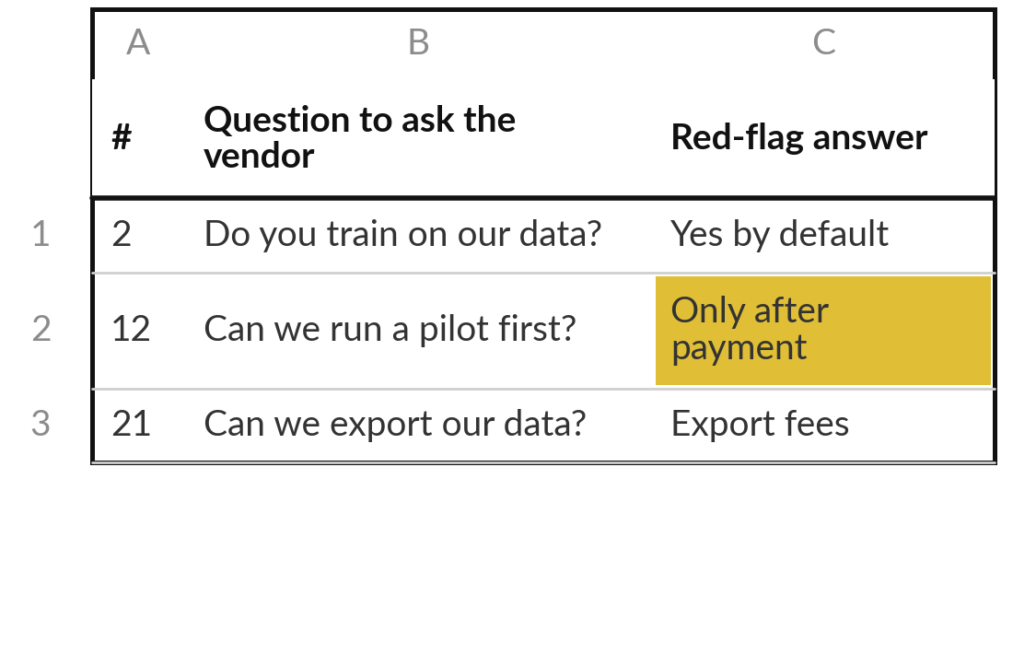
Practice: write five questions
with the red-flag answer
15 minutes
Your own company task
Pick the five questions that matter most for your task.
Start from your three gaps.
Pick five from the list, or write your own.
Add the answer that would be a red flag.
Put them in the order you will ask.
You keep: Five questions with red-flag answers, ready to send in writing.
Notes:
Another fifteen minutes. Turn your gaps into five questions. Use the numbers on the list or write your own. If your task involves personal data, a question about data use and storage belongs on the list. If it involves money, ask about approval steps and caps. For each question, write the answer that would worry you, the red-flag answer, so that you know it when you hear it.
Then put the questions in the order you will ask them. If you have a real vendor in mind, the questions are ready to send.

Slide 19
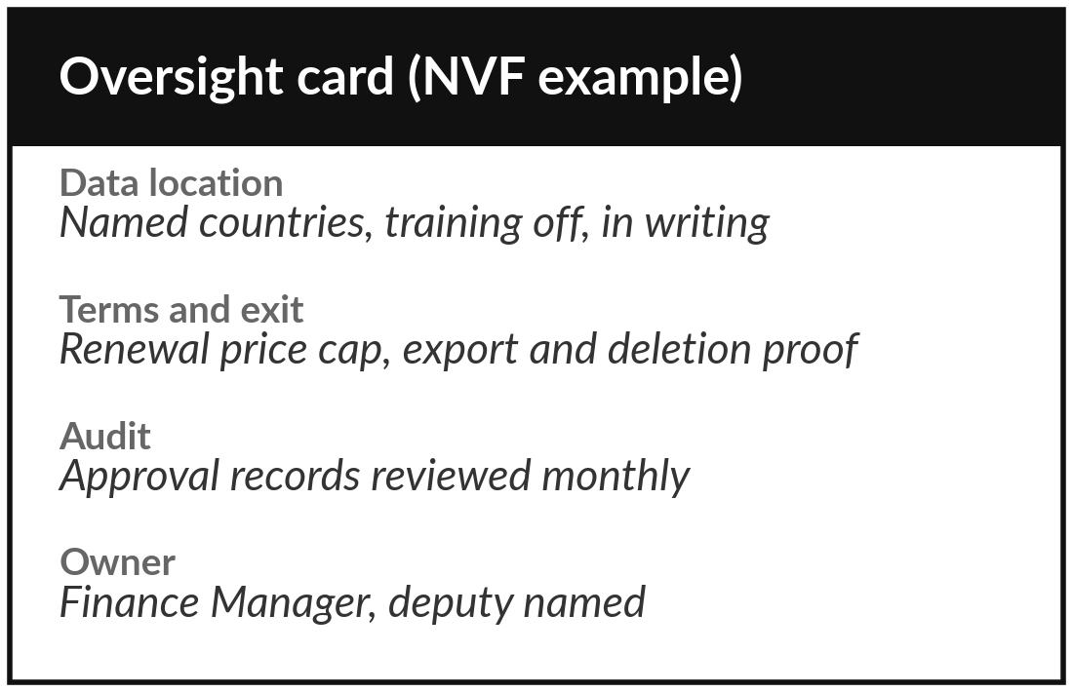
Practice: set the five
oversight controls for the tool
15 minutes
Your own company task
Fill in the oversight card on your Workbook page for the same tool.
Data location: write the countries and the training setting you need.
Terms and exit: write the caps, the notice and the deletion date you would ask for.
Audit: write what you will review and how often.
Owner: name one owner and a deputy.
You keep: An oversight card with the five controls and an owner for one tool.
Notes:
The last fifteen minutes of your own work. Open your Learner Workbook page and make an oversight card for the same tool. Write the countries and the training setting you need. Write the caps, the notice period and the deletion date you would ask for. Write what you will review and how often, for example approval records every month.
And name one owner and a deputy. If the tool is already in use, this card shows where you are exposed today. If you only write one line, write the owner, because a tool without a named owner has no oversight at all.

Slide 20



Decision: build, buy or partner for your own task?
Which route will your business case in Session 11 cost?
Build
Buy
Partner
The task is yours alone, and your own people can make and run a workflow like Sessions 6 and 8.
Many companies share the task and a product is proven on your kind of data. Pilot first.
You need set-up and support you lack. Keep data ownership and exit terms.
Write the route, the reason and the first step on your oversight card.
Notes:
Decide for your own task, because next session you cost the route you choose. Build if the task is yours alone and your own people can make and run a workflow like the ones in Sessions 6 and 8. Buy if many companies share the task and a product is proven on your kind of data, with a pilot first.
Partner if you need set-up and support that you lack, and you keep data ownership and exit terms in your hands. There is no best route. Say your choice and your reason aloud, then write the route and the first step on your card.

Slide 21
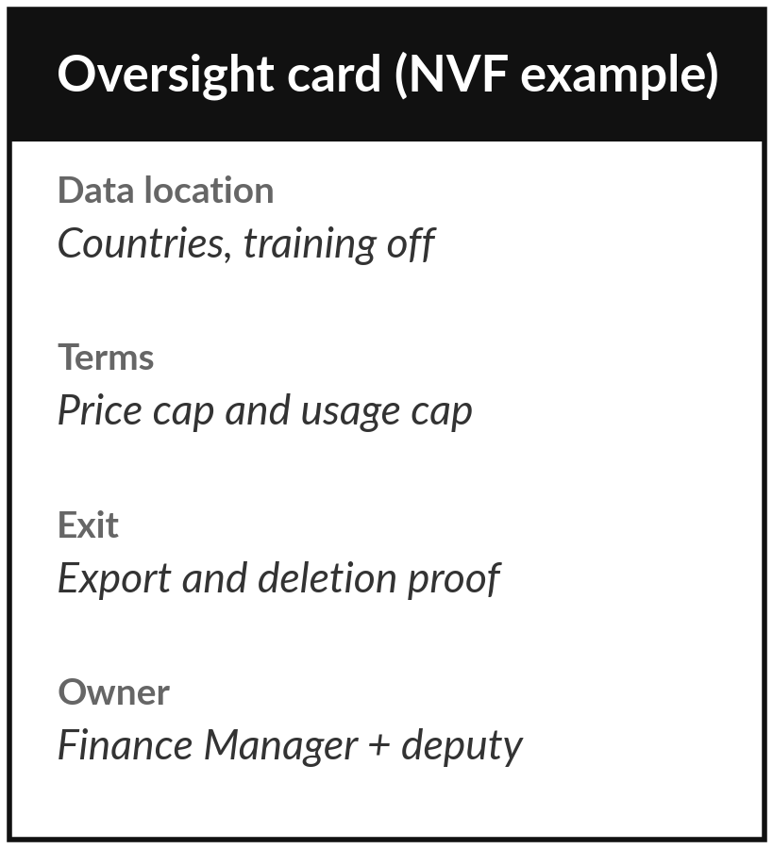
Save your questions and your oversight card
What you keep from today
Your five vendor questions, your oversight card for one tool, and a build, buy or partner choice for your own task.
Our question today
How do I question a vendor, and how do I keep control of what I buy?
Next session
Session 11: The business case. Please bring your Task Card and a rough hourly cost of the staff who do the task.
Notes:
Save your five questions and your oversight card together, next to your policy draft from Session 9. If you send the questions to a real vendor, keep the written replies. They are your evidence. For Session 11, please bring your Task Card and a rough estimate of the hourly cost of the staff who do the task.
Optional: write down what the tool would cost in hours and in shillings in the first year. Next time we put numbers on a business case.
We began with this question: How do I question a vendor, and how do I keep control of what I buy? Before you go, say in one sentence what you can now say about it.

